Slide 1
Source Code Control
For CSE 3902
By: Matt Boggus

Slide 2
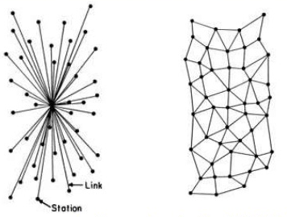
Source code control options for CSE 3902
Must use source code control that is integrated with Visual Studio
Two options
Team Foundation Version Control (subversion or SVN based)
Centralized ; one repository
GIT
Distributed ; every machine is a repository
More on the differences here
Image from http://www.slideshare.net/premaseem/git-presentation-10589300

Slide 3
Setup for source control in Visual Studio
In Visual Studio,
Team->Connect to…
In Team Explorer, Select Team Projects…
Click Servers… button, then Add…
Copy-paste URL from the project creator, then click ok
Should look something like this: https://TEAMORPROJECTOWNERNAME.visualstudio.com/
Select server to connect, signing in with the same account you set up for Visual Studio Online task planning

Slide 4
Working with TFVC
In Visual Studio, connect to your team’s project
First time setup
Set local directory where you will store your copy of the project
Map & Get
Day-to-day use
Under Team Explorer, click Source Control Explorer
Right click on root folder->Get latest version
After adding code and successfully rebuilding the solution, check in the changes

Slide 5
Working with GIT
In Visual Studio, connect to your team’s project
First time setup
Clone repository on your local machine
Day-to-day use
Under Team Explorer, click Source Control Explorer
Fetch commits
Pull commits
After adding code and successfully rebuilding the solution, push your commit

Slide 6
Link to examples (merging)
A Visual Guide to Version Control
https://betterexplained.com/articles/a-visual-guide-to-version-control/

Slide 7
Source control and visual studio project files: An example problem
MarioCoder’s .proj file
BlockCoder’s .proj file
<Project xmlns="http://schemas.microsoft.com/developer/msbuild/2003">
<ItemGroup>
<Compile Include="helloworld.cs" />
</ItemGroup>
<Target Name="Build">
<Csc Sources="@(Compile)"/>
</Target>
</Project>
<Project xmlns="http://schemas.microsoft.com/developer/msbuild/2003">
<ItemGroup>
<Compile Include="helloworld.cs" />
</ItemGroup>
<Target Name="Build">
<Csc Sources="@(Compile)"/>
</Target>
</Project>

Slide 8
Avoiding problems with source control and visual studio project files
Only allow 1 person to add new files to project / commit changes to project file
Update before committing
Some version control supports locking files

Slide 9
Additional misc. notes
The shorter the time between getting code updates and committing new code, the less likely you will break the build
Braches and merging add complexity to the source code control process
GIT is currently the most popular source code control paradigm
The GUI options in Visual Studio for GIT are significantly less powerful than the command line options

